Slide 1


Xplorant - PHP Training in Chennai
PHP TRAINING
IN CHENNAI
http://xplorant.com/php-training-in-chennai/

Slide 2
Xplorant - PHP Training in Chennai
PHP Training in Chennai
Learn PHP training in chennai from beginner level to advanced expert level with our professional trainers. PHP – Hypertext preprocessor is a server side scripting languages designed for web based developments now it is also used an general purpose programming language.
Our PHP Training in chennai will be both practical and theory based one, students will be trained based upon the interview aspects too.
http://xplorant.com/php-training-in-chennai/

Slide 3
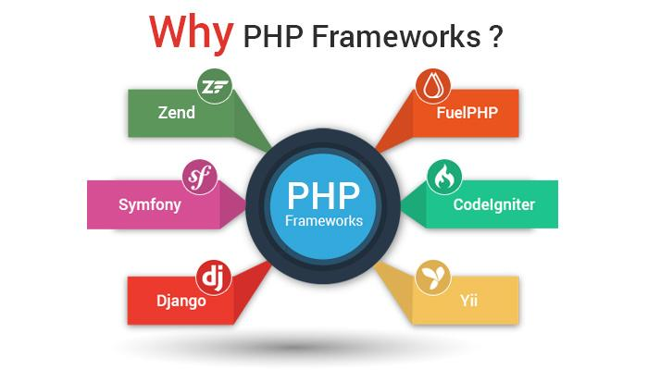
Xplorant - PHP Training in Chennai
Pre-requisites to have iOS training:
We expect you to have knowledge of web
development before enrolling for PHP
training classes. (Student / Professionals).
We provide you a PHP Training in chennai with
certification from our Xplorant Training Institute
after your successful completion of the course,
and also help you to prepare for authorized certifications.
http://xplorant.com/php-training-in-chennai/

Slide 4

Xplorant - PHP Training in Chennai
PHP Training in Chennai Syllabus
Basics of Web and PHP
Data Types
Control Structuresssions
Debugging
User Defined Functions
Creation of webpages with PHP
Working with Forms
Working with Form Data
Cookies and Sessions
http://xplorant.com/php-training-in-chennai/

Slide 5

Xplorant - PHP Training in Chennai
PHP Training in Chennai Syllabus
Accessing Mysql with PHP
CMS
Site Navigations
CRUD Applications
Building of Public area
Page access
PHP advanced Techniques
Fundamentals of OOPs Concepts
Files and directories working
Email Sending
http://xplorant.com/php-training-in-chennai/

Slide 6
Xplorant - PHP Training in Chennai
Contact Us
No 87, Radha Nagar first street, Perumbakkam main road, Perumbakkam,
Chennai – 600100
Ph : +91 9940344422
E-mail: info@xplorant.com
Website: www.xplorant.com

